Slide 1

Traffic Data analysis using Waze dataset
(Submitted as a Trial assignment to thinking machines data science)
- Shoumik Goswami

Slide 2
Agenda
Objective and approach to the problem
Understanding the Waze dataset
Insights generated from the data
Key Takeaways
Possible data solutions to the problem

Slide 3
Objective
Understand the traffic dataset generated from Waze and derive possible solutions to reduce traffic congestion.
Approach to the problem
Obtain the dataset, followed by data cleaning
Understanding the dataset and attributes
Deep dive into the data using Exploratory Data analysis
Insight generation
Solution recommendation based on insights

Slide 4
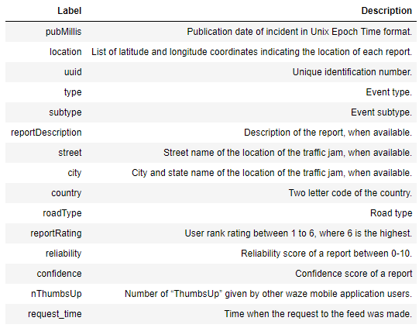
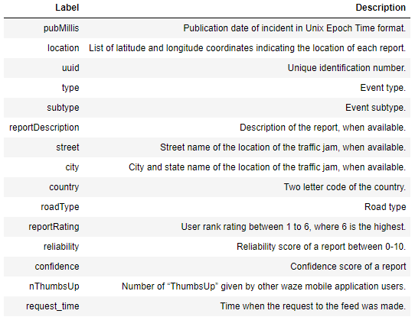
Understanding the dataset and attributes
Data source –
The test dataset consists of Waze all alerts and jams made between "2017-07-08T16:00:00.000Z" and "2017-07-15T16:00:00.000Z" and falling within an 1km radius of 14°33'02.2"N 121°03'02.4"E (14.550620, 121.050666) -- roughly the center of Bonifacio High Street. The coordinates in the dataset use the WGS 84 spatial system.
Data Attributes –
Alerts Dataset
Jams Dataset

Slide 5
Insights generated from the data
What do we know about the data in the dataset?
The dataset contains two sub-datasets – - Alerts dataset which contain alerts generated by users due to some event (accident, road blocks etc.) [User data] - Jams dataset which contain details of each jam event, delay it has caused, location of the jam etc. [Traffic data]
The data belongs to events in two cities – Taguig and Makati in Philippines
The dataset has different categories of reporters based on their reliability scores and reporting activities
Each event in alerts dataset has been classified into different types and has a location data assigned to it
The jams dataset provide detail description of every jam including the location, the type of turns ahead, delays and speed of vehicles

Slide 6
Insights generated from the data
What are the different categories of users and events?
Alerts dataset –
Users are ranked between 1- 5 based on activity and reliability scores
There are 6 different types of roads and 6 different types of street locations
4 major alert types – Jam, Weather hazard, Accident and Road closed
23 sub types of events e.g. Major accident, minor accident, hazard due traffic lights etc
Confidence scores ranging from -1 to 5
Reliability scores ranging from 5- 10
Jams dataset –
5 different types of jams – None, Small, Medium, Large, Huge
5 levels of traffic congestion ranging from 1 -5
There are 4 different types of roads and 76 types of street locations
Insights - The reliability level ranges from 5 - 10 - this also suggests that most of the alerts are marked reliable. The jam data have less road types but more street types. Its possible that the user shares the alert in one street but the jam is spread out on a larger area - covering more streets.

Slide 7
Insights generated from the data
What are the type of events which usually occur in both cities?
Insights - The number of accidents in Taguig are exponentially higher, which is a cause of concern. The city requires a lot of work to improve road safety and traffic measures.
Reporters who are ranked highest are least active in reporting events

Slide 8
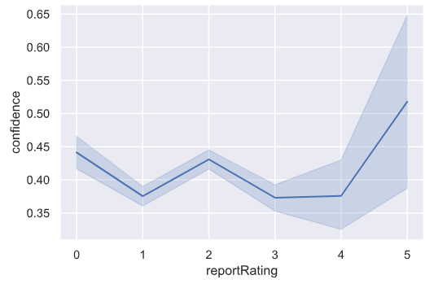
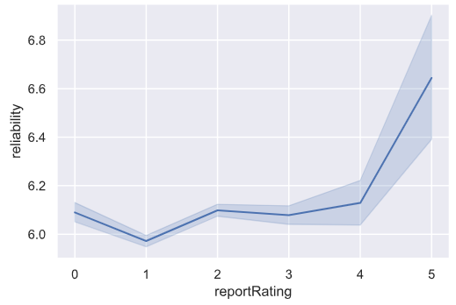
Insights generated from the data
How are confidence and reliability scores related to reporter rank?
Insights - Only higher ranked reporters have high confidence scores. Also, most of the reporters receive less than 50% confidence scores, which indicates that most of the reports do not receive feedbacks from other users.
Reliability shows the trustworthiness and experience of a reporter. Therefore, we can see from the graph that as the rating increases so does the reliability.

Slide 9
Insights generated from the data
How are confidently and reliably each event is reported?
Insights - Accidents are reported with very high confidence level, which is a sign that people are very active in reporting accidents. They are reported by reliable reporters so the information is likely to be correct in most of the cases.
This is a valuable insight as this data can be used to take proper measure during accidents.

Slide 10
Insights generated from the data
How does the jam impact speed and delay of the traffic?
Average speed per jam level
Level 0 is: N/A
Level 1 is: 11.23 km/hr
Level 2 is: 8.57 km/hr
Level 3 is: 6.82 km/hr
Level 4 is: 3.89 km/hr
Level 5 is: 0.0 km/hr
Average speed per jam type
None is: N/A
Small is: 4.2 km/hr
Medium is: 3.8 km/hr
Large is: 3.2 km/hr
Huge is: 1.35 km/hr
Maximum delay per jam level
Level 0 is: N/A
Level 1 is: 2.25 min
Level 2 is: 9.32 min
Level 3 is: 24 min
Level 4 is: 2 hours
Level 5 is: - 1 (Blocked)
Maximum delay per jam type
None is: N/A
Small is: 1.25 hours
Medium is: 1.52 hours
Large is: 1.75 hours
Huge is: 1.97 hours
Insights – Jam type level 3, 4 and 5 have significant impacts to the traffic congestion and can be attributed to significant events like an accident or a road block.

Slide 11
Insights generated from the data
How are road types and jams related?
Insights - Road type 1 are heavily congested, this may be due to the fact that the roads are closed. Type 1 roads may be small roads or least maintained - due to which they are heavily impacted by weather hazards as well.
As the type of road increases in value, the congestion and events reduce in numbers. Road type can be a sign of road quality.

Slide 12




Insights generated from the data
What does a typical accident event look like?
Event – Major accident in Lane Q, Taguig city on 10th July, 2017 at 1:30 AM
1:30 AM
1:30 – 2:00 AM
2:00 – 2:30 AM
Post 3:00AM
Major accident in Road Type - 1
Level 4 traffic congestion with a delay of 4.5min
High ranking reporters started sending alerts
Congestion is cleared and traffic reduced
Most of the reporters had high reliability scores and reported the incident for about half an hour. Once everything was taken care of, the traffic congestion reduced and people were able to move. This can be seen in the change of congestion level and delay which drastically reduced post 3 AM.

Slide 13
Key Takeaways
The number of reported events in Taguig city is very high which may be due to blocked roads and frequent accidents. If the infrastructure is improved based on the data, conditions will improve.
Most of the accidents and road hazards are reported promptly by reliable reporters – it is possible to take impromptu action to reduce the impact of the accident. The data reveals the exact location of the event which can be used efficiently, reducing congestion.
Road type 1 should be the focus of concern as most accidents and road hazards occur in these roads. They also give rise to road blockades. These roads need proper attention and development to minimize traffic congestion.
Jam levels 4 and 5 should be the focus points as they lead to heavy delays – sometimes upto 2 hours.
High ranking reporters should be encouraged to actively participate in generating alerts because they are recognised by other users. It will improve the traffic re-routing and emergency measures.

Slide 14
Possible data solutions
Emergency notifications – using the streaming alerts and jam data, emergency push notifications can be sent out to nearby NGOs and agencies to provide support during major accident cases having high delay timings.
Predictive tool for jam – Based on the alerts data, no. of responses and jam details, a tool can be used to predict high impact events and mobilise resources to provide support.
Road condition detection – Based on the frequency of events occurring in particular road types and street locations, a monitoring tool can be used to identify poor road conditions and improve on the infrastructure.

